Slide 1



Exploring Machine Learning Classifiers:
Understanding, Comparing, and Optimizing

Slide 2
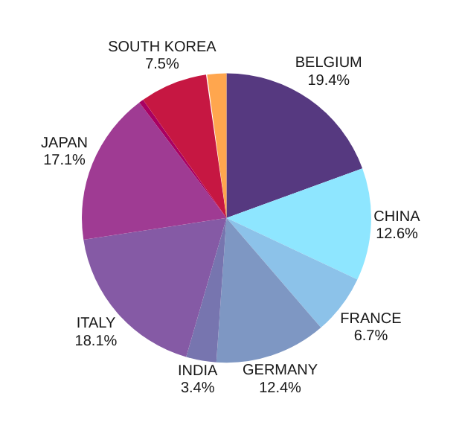
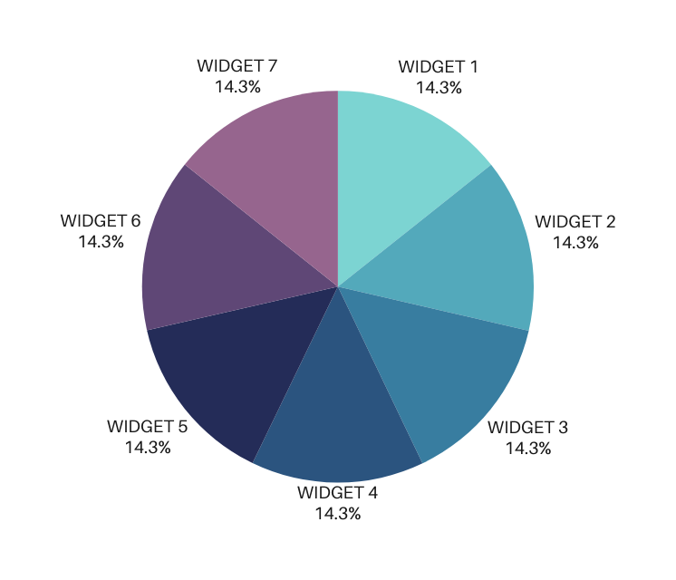
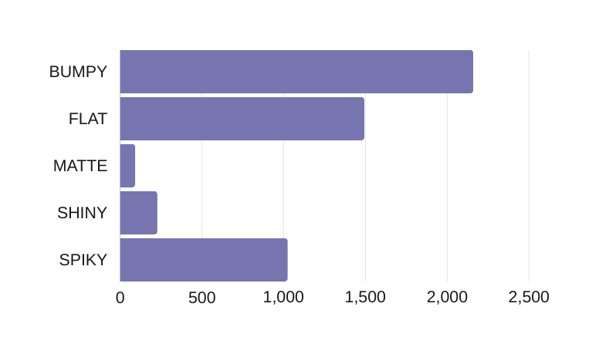
DATASET
VISUALIZATION
LOCATION
Pie chart featuring Location distribution
SURFACE
This stacked Bar Chart features the different surafce distribution in the dataset
FIGURE: PIE CHART FEATURING THE TARGET DISTRIBUTION

Slide 3
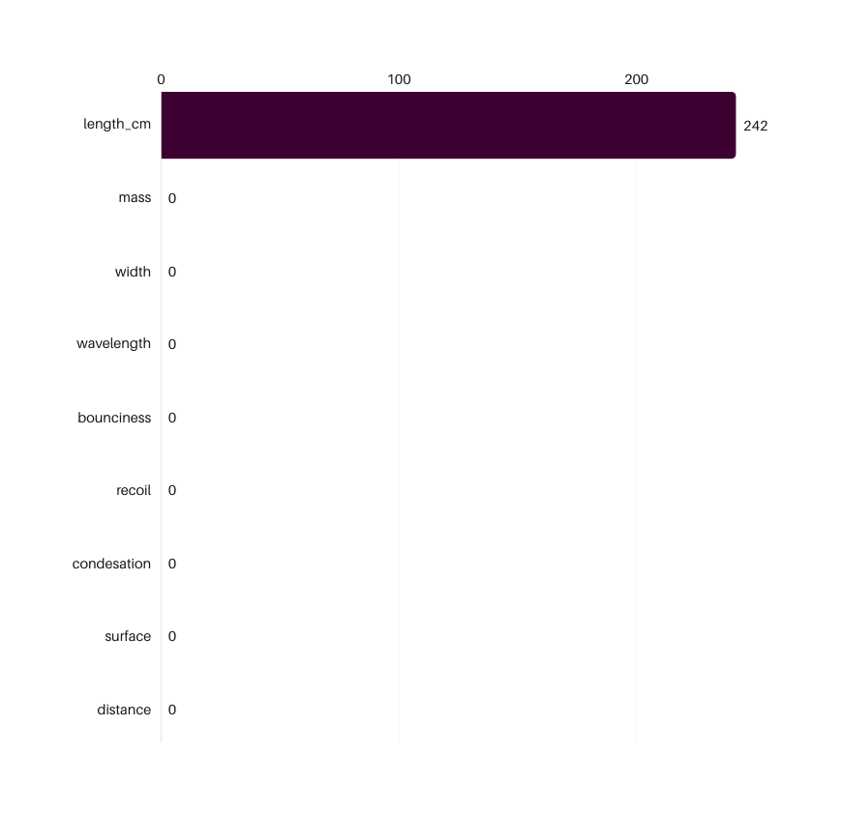
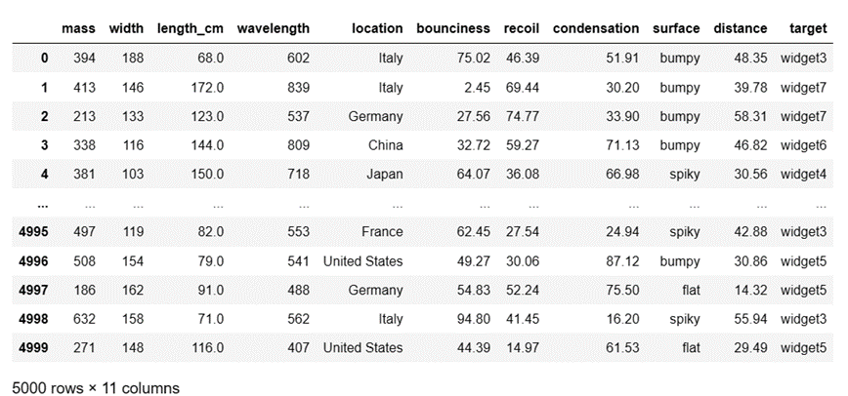
TARGET DISTRIBUTION AND FEATURE VALUES ANALYSIS
8
2
1
NUMERICAL FEATURE
CATEGORICAL FEATURE
TARGET
DATASET TABLE OF ALL FEATURES AND TARGET
FIGURE :BAR CHART FEATURING MISSING VALUES

Slide 4
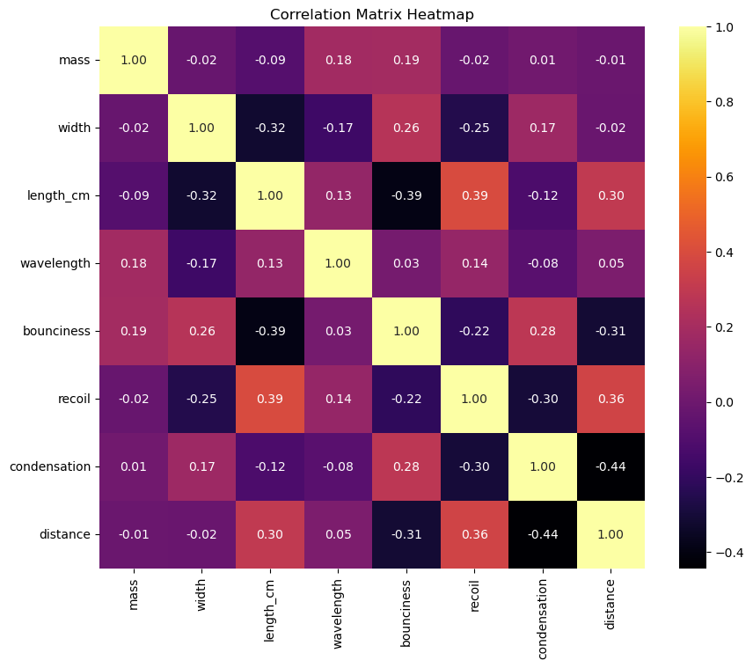
CORRELATION MATRIX
This table represents the correlation coefficients between different features in a dataset:
+1 implies a strong positive correlation,
-1 implies a strong negative correlation,
0 implies no correlation.
ANALYSIS:
"Distance" and "Condensation" have a strong negative correlation.
"Recoil" has a moderate positive correlation with "Length_cm."
"Bounciness" shows a moderate positive correlation with "Width."
This correlation analysis helps understand relationships between features, assisting in feature selection or understanding multicollinearity in predictive modeling.

Slide 5
MACHINE LEARNING CLASSIFIERS

Slide 6
MACHINE LEARNING CLASSIFIERS
Comparative Analysis of Popular Machine Learning Classifiers
NAIVE BAYES
RANDOM FOREST
SUPPORT VECTOR MACHINES
Type: Probabilistic
Based on Bayes' theorem with an assumption of independence between features
Type: Ensemble(Decision Trees)
Constructs multiple decision trees and merges them to improve accuracy and reduce overfitting.
Type: Discriminative
Finds the hyperplane that maximizes the margin between classes.
01
Efficient and simple.
Works well- high-dimensional data.
Performs well in case of categorical input variables compared to numerical variables.
02
Handles complex interactions.
Reduces overfitting.
Effective for both classification and regression tasks.
03
Effective in high-dimensional spaces.
Versatile-different kernel functions.
Handles non-linear data well through kernel tricks

Slide 7
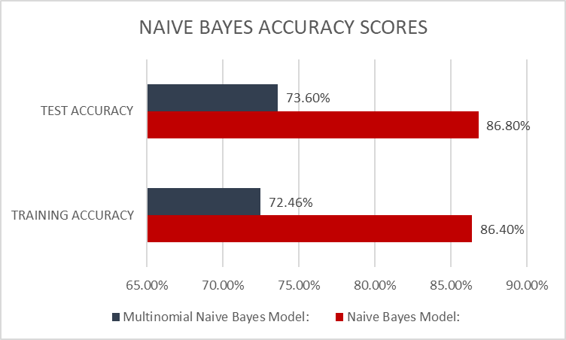
NAIVE BAYES
70/30 SPLIT
86.40%
NAIVE BAYES VS. MULTINOMIAL NAIVE BAYES ACCURACY
Achieved accuracy with 0.3 test size
NAIVE BAYES ACCURACY SCORE
Gaussian Naive Bayes assumes continuous data, while Multinomial Naive Bayes is suited for categorical data.
OBSERVATION
Naive Bayes outperforms Multinomial Naive Bayes on both training and test data.
Multinomial Naive Bayes shows slightly lower accuracy scores compared to the standard Naive Bayes model.

Slide 8
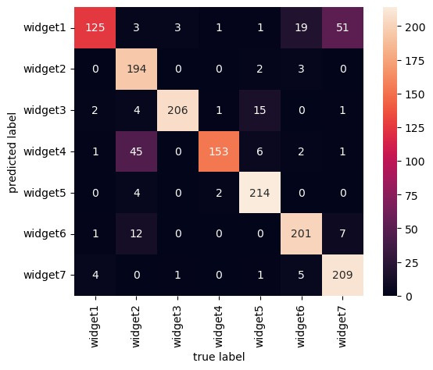
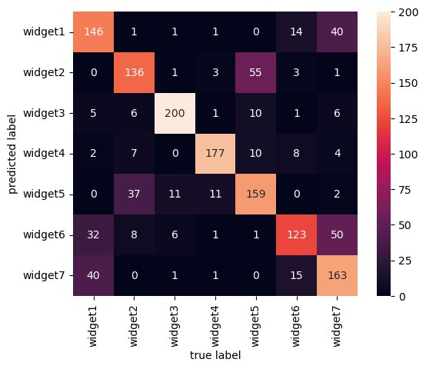
CONFUSION MATRIX- NAIVE BAYES
GUASSIAN NAÏVE BAYES
MULTINOMIAL NB CLASSIFIER

Slide 9
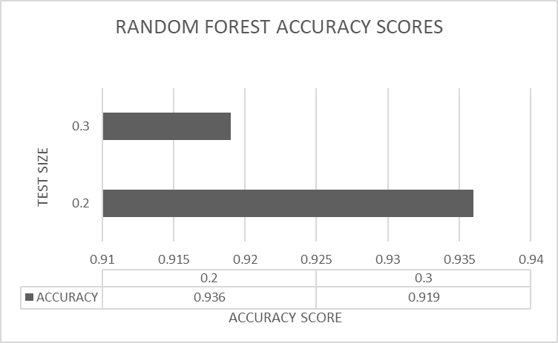
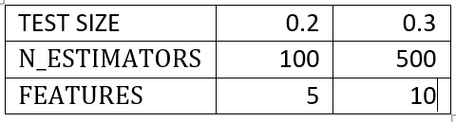
RANDOM FOREST
93.6%
91.9%
HYPERPARAMETERS
Achieved accuracy with 0.2 test size
Achieved accuracy with 0.3 test size
Number of Trees (n_estimators): Higher values generally lead to better performance but can increase computation time.
Maximum Features (max_features): The number of features considered for splitting at each node. Lower values may reduce overfitting.
OBSERVATION
Test size of 0.2 produced higher accuracy compared to 0.3.

Slide 10
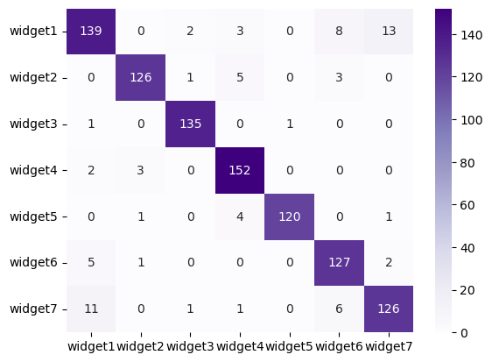
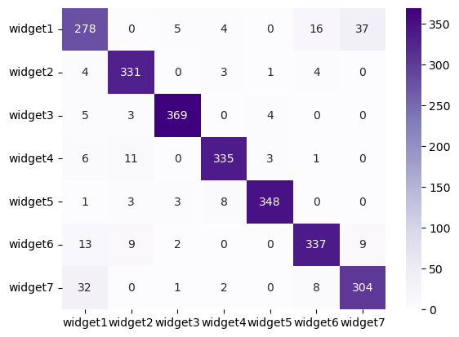
CONFUSION MATRIX- RANDOM FOREST
(A)
DATA SPLIT 80/20
(B)
DATA SPLIT 70/30

Slide 11
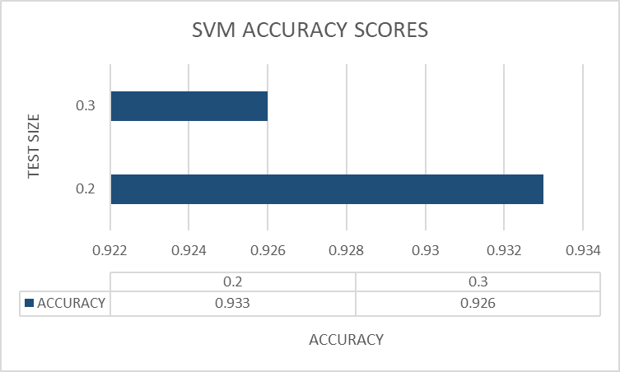
SUPPORT VECTOR MACHINES
93.3%
92.6%
HYPERPARAMETERS
Achieved accuracy with 0.2 test size
Achieved accuracy with 0.3 test size
Kernel: SVMs use kernels to transform input data into higher-dimensional spaces, making it easier to classify non-linearly separable data. Best parameters : Linear/ RBF
C: The C parameter in SVMs controls the trade-off between maximizing the margin and minimizing the classification error. Best parameters 0.1, 1,10
OBSERVATION
a change from 0.2 to 0.3 might have led to a slight decrease in accuracy

Slide 12
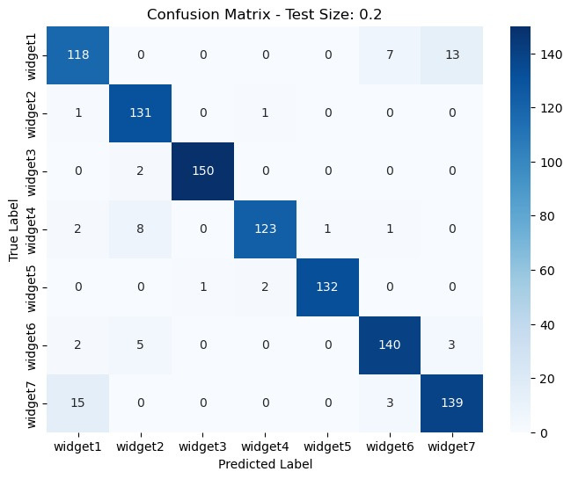

CONFUSION MATRIX- SUPPORT VECTOR MACHINE
(A)
DATA SPLIT 80/20
(B)
DATA SPLIT 70/30

Slide 13
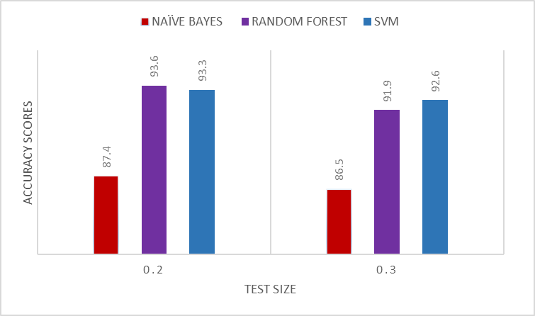



MODEL ACCURACY EVALUVATION
ACCURACY SCORES
NAIVE BAYES
WITH DIFFERENT TEST SIZE
87%
91%
RANDOM FOREST
Random Forest or SVM might be preferable choices for accurate predictions due to their consistent performance across different test sizes.
SUPPORT VECTOR MAHCINE
92%

Slide 14
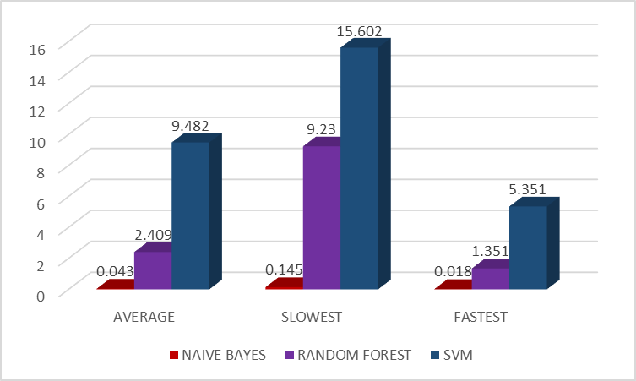
COMPARATIVE ANALYSIS OF TRAINING TIMES
NAIVE BAYES
RANDOM FOREST
SUPPORT VECTOR MACHINE
SLOWEST: 0.145s
FASTEST: 0.018s
AVERAGE: 0.043s
SLOWEST: 9.235s
FASTEST: 1.351s
AVERAGE: 2.409s
SLOWEST: 15.602s
FASTEST: 5.351s
AVERAGE: 9.482s
Most time-efficient algorithm IS NAIVE BAYES,
while on a larger dataset with complex relationships
SVM might exhibit better efficiency compared to RANDOM FOREST.
TRAINING TIME FOR EACH CLASSIFIER IN SECONDS
Test Size= 0.3

Slide 15
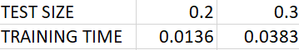
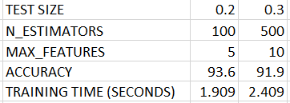
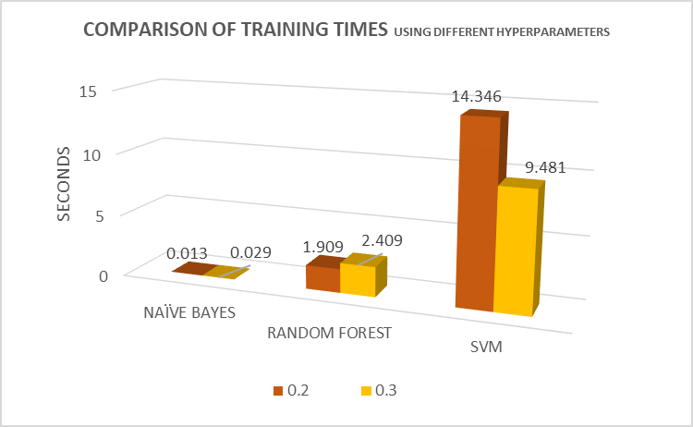
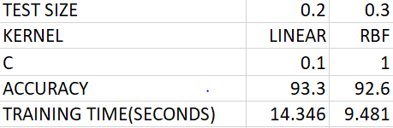
COMPARISON USING DIFFERENT HYPERPARAMETERS:
NAIVE BAYES
RANDOM FOREST
SUPPORT VECTOR MACHINES

Slide 16
Choosing the best model depends on the specific dataset and the trade-offs between accuracy and interpretability. Random Forest excels in handling complex relationships but might overfit, while Naive Bayes offers simplicity and works well with smaller datasets.
The choice ultimately hinges on the dataset's characteristics and the desired balance between accuracy and simplicity.
CONCLUSION

Slide 17

THANK YOU
SYED ARHAM
TANMISHA MURALI
AANISAH JAHAN

